Slide 1
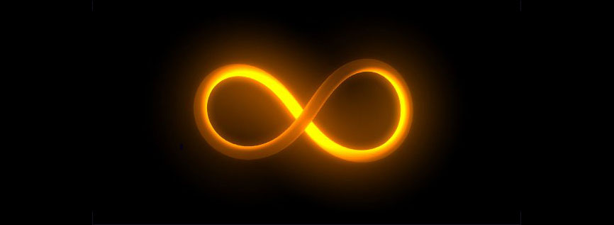
Un-Written Figure:

Slide 2
Un-Written Figure:

Slide 3
Un-Written Figure:

Slide 4
Un-Written Figure:

Slide 5
Un-Written Figure:

Slide 6
Un-Written Figure:

Slide 7
Un-Written Figure:

Slide 8
Un-Written Figure:

Slide 9
Un-Written Figure:

Slide 10
Un-Written Figure:

